Slide 1
Fintech Credit

Slide 2
Contents
Fintech Credit – Trend
Current Analytics Capabilities
Background - Fintech credit
Focus Areas For Improvement - Future
Business Goals
Fintech Credit – Process flow
P2P Lending –Transaction flow
Analytics –Peer Comparison
Industry Growth – Key drivers
Industry – Fintech Credit Context
Fintech Credit- Culture
Company Culture
Control Culture –Challenges
References

Slide 3
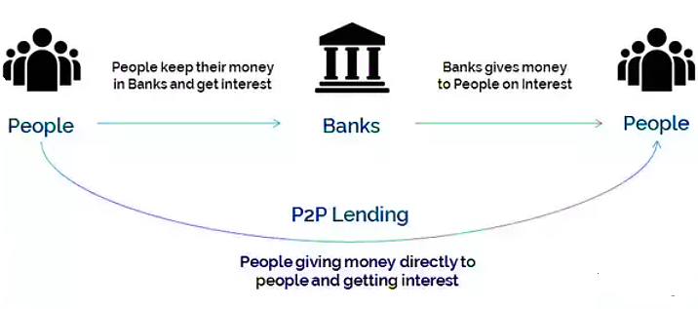
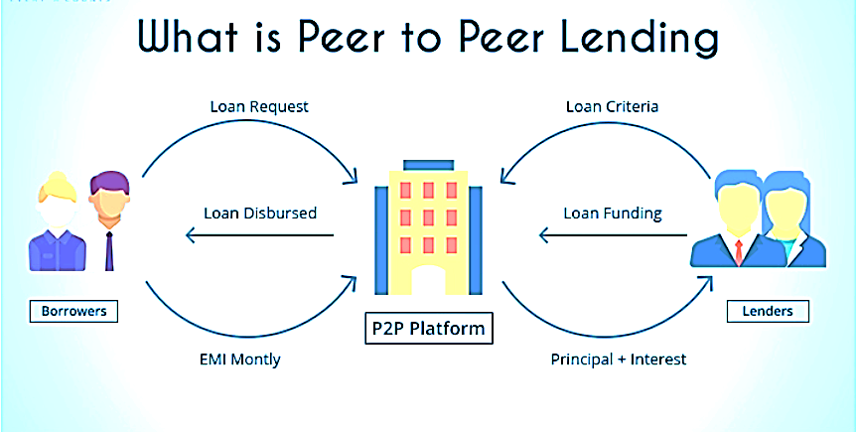
Background - Fintech credit
Fintech credit is founded and operated in Australia (Aus) and New Zealand (NZ). This include all credit activity facilitated by electronic (online) platforms and are not operated by consumer/commercial banks. This definition of fintech credit encompasses all credit activity facilitated by platforms that match borrowers with lenders (investors).
Depending on the jurisdiction, these platforms are referred to as “peer-to-peer (P2P) lenders”, “loan-based crowd funders” or “marketplace lenders”.
Fintech credit has grown rapidly in recent years. Estimates from the Cambridge Centre for Alternative Finance (CCAF) indicate that $51 billion in such credit was extended in 2018, up from $5 billion in 2013.

Slide 4
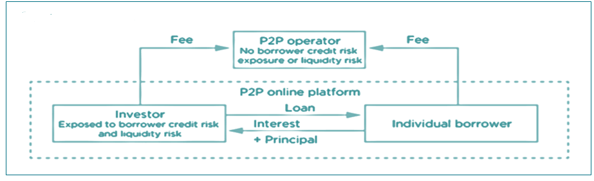
P2P Lending –Transaction flow
Fintech credit is a peer to peer lending company operates in Aus and NZ. It provides an online platform on which an investor lends to potential borrower considering borrower’s credit score grade. Fintech credit earns transaction fee from both investor and borrower on each successful new loan.
Investors earns profit (interest amount) from borrowers with risk weighted interest rates on lending amounts.
Borrowers with low/no credit history have better chances of getting credit from investors in Fintech credit compared to Consumer/Commercial Banks.

Slide 5
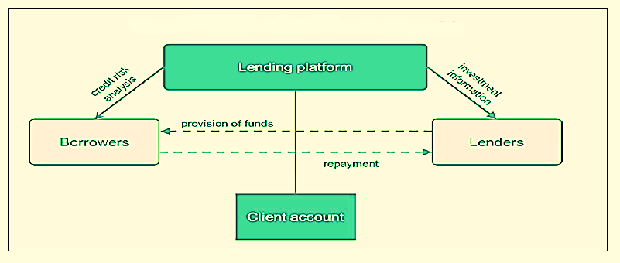
Fintech Credit – Process flow
Fintech credit online lending works on
Sophisticated Machine learning algorithms to assess borrowers credit risk.
Calculates optimized risk weighted interest rates to support a competitive lending platform.
Loan origination and risk management reports for lenders to maintain a distributed optimized risk portfolio.
Information management system to track the loan originations and profits for Fintech Credit.
Explore the borrowers data which captures credit behavior of borrowers & lenders. Integrate such data with decision engines.

Slide 6
Fintech Credit – Process flow
For Lenders: Fintech credit provides
Credit risk grade for each borrower by assessing their credit risk.
Risk weighted interest rates for each borrower which helps the investors in selecting appropriate borrower.
Lending suggestions and reporting for lenders to maintain optimized risk and profitable portfolio.
For Borrowers: Fintech credit provides
Self credit risk assessment.
Optimal interest rates and tenure program considering the own credit risk grade.
Quick loan processing with minimal documentation.

Slide 7
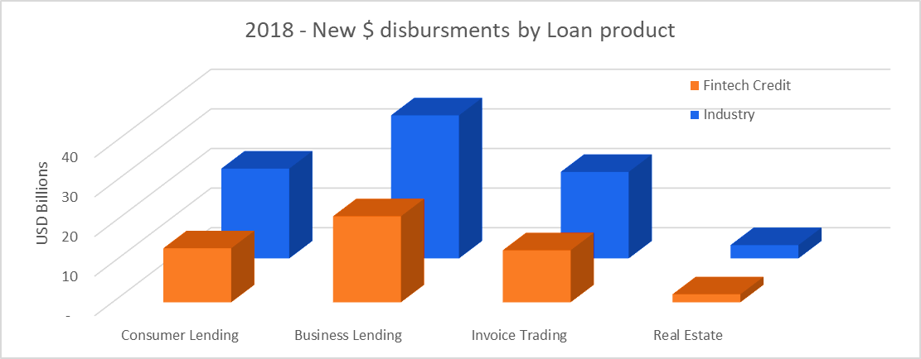
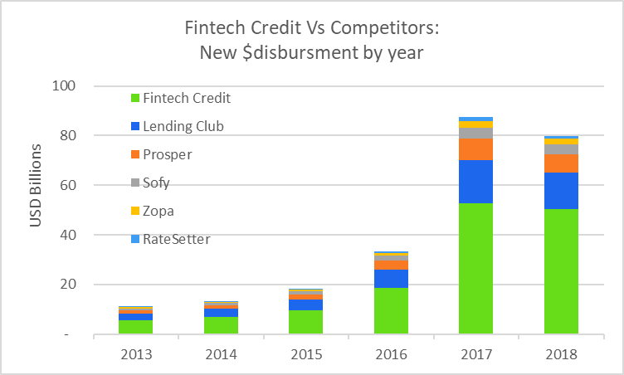
Industry – Fintech Credit Context
Fintech credit established online peer-to-peer lending platform in 2010. As of 2018,
The $ disbursement for new loans issued in 2018 were raised to 80 Billion USD(2010 < 1 Billion USD, 2013 ~ 5 Billion USD).
Expands the peer-to-peer lending platform to 4 business platforms includes Consumer lending, Business Lending, Invoice Trading and Real estate.
Captures more than 50% of $ disbursement for new loans issued each year since 2013 across industry.
Compare to other competitors in the industry Fintech Credit consistently leading the industry since 2013.

Slide 8
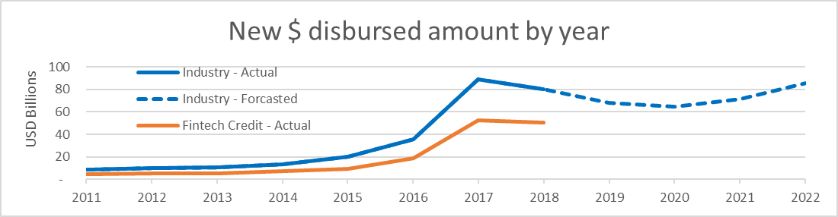
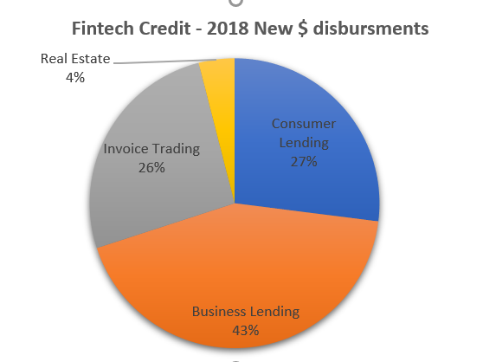
Industry – Fintech Credit Context
Fintech Credit - Key Highlights:
Diversified Market Leader in Online Loan Shopping
Dominant share in Business, Consumer and Invoice lending.
Unparalleled Scale in $ loan disbursements and Brand
Massive Industry shift from conventional banking to Online peer-to-peer loans.
Robust growth along with profitability due to large number of disbursements. Also, benefits both investors and borrowers.

Slide 9
Industry Growth – Key drivers
Supply factors:
Technological advances in computing power.
A typical feature of online platform-based business models is their ability to scale.
Traditional lenders have a relatively high fixed cost base due to their branch networks and their need to maintain existing IT systems, higher capital, liquidity and regulatory costs.
Traditional lenders withdrew from some market segments in the post-crisis period. Tax policies and regulations may encourage lending by alternative platforms considering consumers/business with low or no credit profile.
Demand factors:
Higher customer expectations with regard to convenience, speed, cost and user-friendliness of financial services due to Real-time transacting capability of internet-connected devices.
Consumers may now be more willing to use the services of lending market entrants due to their reduced trust in existing lenders following the financial crisis. There may be a more general perception among some consumers that peer-to-peer lending, is more socially responsible and of greater social value than conventional banking.
A desire for higher returns with a larger investor base, including from institutional investors. Investors may regard online peer-to-peer lending as an alternative asset class that can add to diversification of their portfolios.
Technological innovations often display network externalities that drive demand. In the case of P2P lending, in principle it is possible that the higher the investor demand to lend on platforms, the more borrowers may be attracted to use this lending.

Slide 10
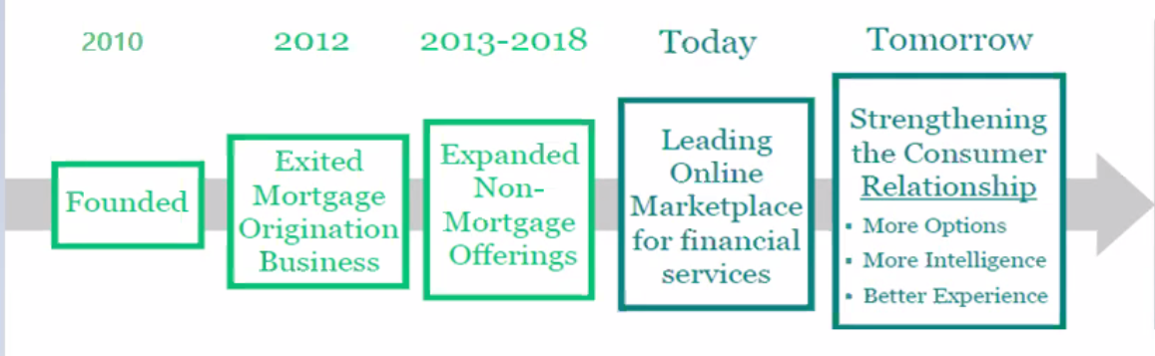
Industry Growth – Key drivers
Factors affecting growth potential:
A competitive responses from incumbent lenders. Banks have been building up their digital banking activities for some years, and the emergence of marketplace lending platforms has sped up this process.
Uncertainty about regulatory frameworks given the rapid development of the industry. This drives tough route to be complaint with upcoming Regulatory requirements and frequent updates.
Fintech Credit Growth since 2010 (Holds more than 50% share in the Industry since 2013):

Slide 11
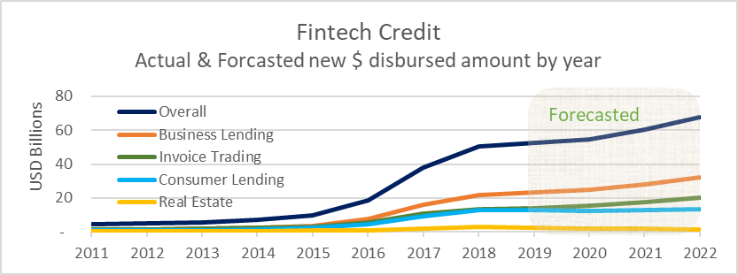
Fintech Credit – Trend
Focused items
The Real estate portfolio is expected to be stable in terms of $ disbursements with a low or negative growth. This is due to Real-estate business is stable in the region. Also due to the competition from the conventional banks with lower interest rates and flexible products is high.
Invoice Lending and Business Lending has a strong data infrastructure. Fintech planning to expand the lending business in these areas due to higher commission's, increase in international trades, increasing new SME’s in the country.
Consumer lending is very competitive in the industry. Need to enhance the decisioning systems to optimize the commission fee, borrowers credit risk profile and the size of lenders investment amounts.

Slide 12
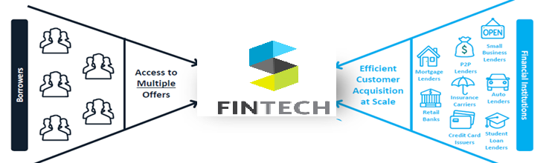
Business Goals
Short term
60% growth in $ disbursements by 2022 for Business lending and Invoice lending.
10 times growth in pooled investments from consumer/business investors by 2022.
Enhance the decision systems infrastructure to facilitate guarantees and customized insurance products.
Enhance the in house data storage and reporting standards to be complaint with upcoming regulations.
Long term
Complaint with regulations.
Partnering with Top Tier lenders across the spectrum to capture maximum customers.
Expand the business in Asia-pacific and Europe countries.
Expand the scope to various markets like
Insurance
Derivatives
Fixed deposits
Enhance Consumers/Commercial investment groups to support both inhouse and cross border lending.

Slide 13
Current Analytics Capabilities
We also identified several aspects that require focus so that Fintech credit can truly flourish in the various market.
Fintech credit holds “Moderate” Analytical capabilities which can maintains the customers data to assess the borrower's credit grading by using predictive analytics(Machine Learning Algorithms) .
Machine learning and AI algorithms for Credit Approval processes
By entering the necessary policies and having it recognize the platform’s borrower assessment patterns, machine learning can transform and refine the entire credit approval process.
Predictive Analytics for Default Prediction
To find patterns in previous non-performing loans and default rates to identify possible future issues
Improved Accuracy
The increasing scale of data availability and storage combined with better computational capacity has the potential to improve the accuracy of the underwriting process..
Detecting Frauds
Machine learning Algorithms to detect fraudulent transactions with increased accuracy by comparing customer behavior with the baseline data of normal customers

Slide 14
Analytics –Peer Comparison
Fintech Credit is one of the leading online financial community that brings together creditworthy borrowers and savvy investors to help both benefit financially. To be at it best when compared to its competitor peers the following strategies are implemented :
Behind the scenes, the Product Analytics team at Fintech Credit is creating infrastructure to make the organization of over 500 employees as self-sufficient as possible.
The team manages
Predictive Analytics,
web analytics,
customer surveys,
customer feedback and
SEO.
Since implementing predictive analytics, the team has already made a big impact. In one big win, they were able to discover small points of friction in the customer experience—a find that’s helped them to serve thousands of additional customers.
Made raw data easy to access. No matter how great the UI in the website might be, Fintech Credit wanted access to their raw data, so they could extract and combine multiple data sources, and run predictive modeling.
Creating a Better Customer Experience by making everyone Data-Informed

Slide 15
Focus Areas For Improvement - Future
We also identified several aspects that require focus so that Fintech Credit can truly flourish in the various market.
Intuitive Mobile Experience
To attain superior product satisfaction and expanded lender capacity and borrower experience.
To run the strategic market campaigns to attract potential investors and appropriate borrowers.
Technology –Big Data
Big-Data components like Cloud-computing , Hadoop, Spark meets the requirements of frequently interacting with diverse platforms for collecting large volumes of diverse data.
Advanced Machine Learning Algorithms
To define the complex and dynamic relationships to predict default. Optimizing the risk & profits not only for fintech credit but also for all investors.
Chat bots
to improve overall customer experience and platform loyalty by taking in the questions and feedback from customers and generate appropriate answers / best practices.
Social Media, Tax data, Investment data, Travel expenses, Purchasing patterns, Inventory analysis for business
Enhance the quality of data systems and Machine learning & AI algorithms to process credit behaviour of the investor and borrower.

Slide 16

Fintech Credit- Culture
Actual
Collaboration
Control
VALUES : Certainty & discourages risk-taking
Personal
Impersonal
Cultivation
Competence
Possibility

Slide 17
Company Culture
Being in the industry of Peer to peer lending , it is very important to provide a safe and trust-worthy environment for the customers which invokes the profits by itself for the organization.
Fintech Credit is one of those traditional organizations which believes in Control culture to ensure the optimization of interest rate for borrowers and profits for lenders.
Since its establishment in 2010 it has been driving as successful players in this industry by playing it safe and by being in less risk taken zone.
Also delivering slow and steady results by maintaining low default rates than most of it competitors.
The Bureaucratic system helped in gaining the major market share and huge customer attention with lesser risk .
Fintech credit is very task-driven by providing customer care 24/7 through online customer care.

Slide 18
Control Culture –Challenges
Being in control culture every organizations faces some challenges , Fintech Credit has easily overcome these challenges by opting the following :
The Product Analytics team helped in minimizing the Long approval cycles.
Hierarchical system helps in maintaining a positive environment to have a less risk zone for the customers by monitoring them closely.
Being Rigidity helped in attaining the trust of the customers and helped in expanding to major market share.
The nature of “disrupting status quo” is one of the key feature of motivation to achieve success in the industry of peer to peer lending .

Slide 19
References
https://www.bis.org/publ/qtrpdf/r_qt1809e.pdf
https://assets.kpmg/content/dam/kpmg/id/pdf/2018/11/id-the-fintech-edge-p2p-lending.pdf
https://www.crediful.com/personal-loans/lendingtree/
https://heap.io/customer-stories/lending-club
https://www.finsia.com/docs/default-source/jassa-new/JASSA-2016-/jassa-2016-issue-3/jassa-2016-iss-3-peer-to-peer-lending-pp-37-44.pdf?sfvrsn=76839b93_4

Slide 20
Thank You !

